Slide 1
Microsoft Bot Framework & Azure Bot Service
Maarten Struys

Slide 2
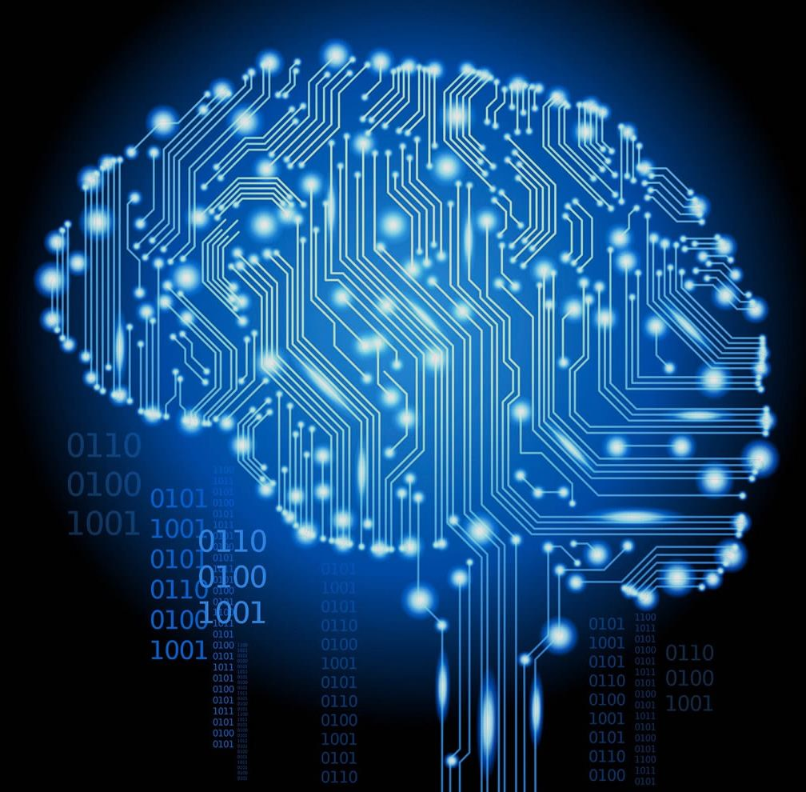
“The world and technology are once again transforming.”
“Computers may win at games, but imagine what’s possible when human and machine work together to solve society’s greatest challenges like beating disease, ignorance, and poverty.”
SATYA NADELLA, CEO MICROSOFT
Notes:
Technology is shifting its platform, utilizing artificial intelligence to create a more natural connection between humans and their devices. Between businesses and their customers.
In essence it is where computing becomes more human.

Slide 3
1990s: Internet
Search
User “visits” websites
The future: Conversations
Natural language between people and technology
Conversational canvas
Bots and agents
1980s: PC
Desktop
2000s: Mobile
Social
User download apps from App Stores
Notes:
This is a similar platform shift that we have seen in decades past
The desktop PC in the 80’s
Which gave birth to the web and new internet services and search
Leading to smartphones and the age of mobile apps
And with each of these new platforms, things became easier; the world became a little smaller and closer. But they’ve also added a layer of complexity.
This next platform shift builds on the past but provides a new level of intelligent or AI experiences that fundamentally augments human ability that fits our behaviors vs. us having to adapt to it.
We call this Conversations as a Platform
It is where Natural Language becomes the user interface
Pull from Narrative
Where Bots are the new apps

Slide 4
Developers
The new canvas
Conversations as a platform
Businesses
The new opportunity
Individuals
More personal way to discover, access, and interact
Notes:
Conversations as a platform benefits developers, business and individuals

Slide 5


Humans
Conversations as a platform
Bots in Conversational Canvas
Personal Digital Assistants
Notes:
Three actors of conversations as a platform

Slide 6

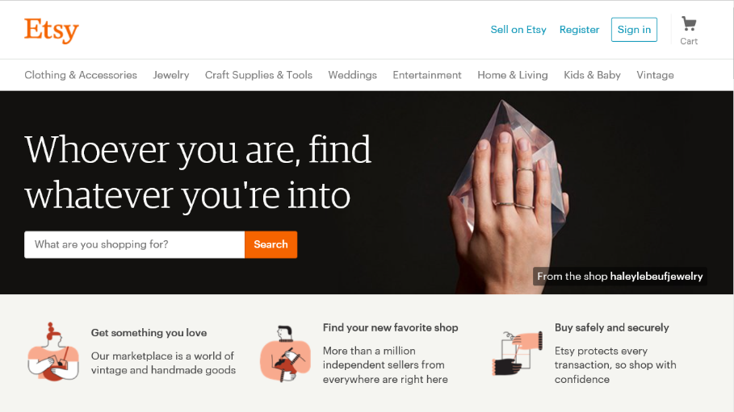
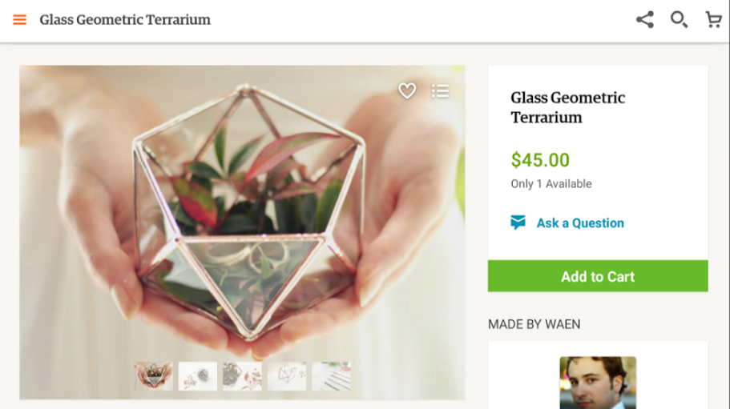
How your brands communicate with customers today
Website
App
Notes:
Currently communicating with mobile-optimized websites and apps
The average number of downloaded and actively used apps on smart phones is less than 20%.
The fundamental problem of the mobile app model is scaling for the tail. For apps that do things like check ferry prices or book travel or find a home to buy, they only get used a few times a year, and for many, even less than that.
The app model does not lend itself well to being there right at the moment when you need it.

Slide 7
Productivity task completion Enhance productivity through task automation and through automated workflows
Reach customers anywhere, on any platform or device
Engage with customers and users in a natural way, conversationally and in context
Expose your products and services via messaging platforms, where users are already highly engaged
Improve customer experience and reduce the need for human assistance
Transforming
engagement

Slide 8
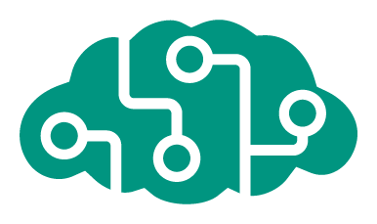

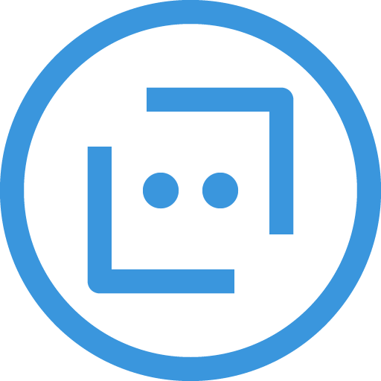
Intelligence platform
Microsoft Bot Framework
Azure Bot Service
Cognitive Services
Notes:
With the Cortana Intelligence Suite, including the Bot Framework and Cognitive Services we’re enabling anyone to build a bot and infuse it with intelligence.
In general, few companies are positioned to deliver on this future. In fact, very VERY few have the necessary ingredients to be build a successful platform.
Microsoft Cognitive Services are a new collection of 22 intelligence and knowledge APIs that enable developers to ultimately build smarter apps.
Vision
From faces to feelings, allow your bots to understand images, videos, and emotions.
Speech
Convert speech-to-text and back again; understand intent, translate languages, filter noise, and identify speakers.
Language
Teach your bots to understand natural language commands, parse complex text, and detect user sentiment.
Knowledge
Incorporate rich knowledge amassed from the web, academia, or your own data.
Search
Access billions of web pages, images, videos, and news with the power of Bing APIs.
Microsoft Bot Framework - enabling developers to build, connect, manage and publish intelligent bots across most popular platforms—45k developers are already building bots, such as StubHub, SkyScanner and Hipmunk.
Think of bots as new applications that you converse with. Instead of looking through multiple apps, or pages and pages of websites, you can call on any application as a bot within this conversational canvas.
Skype is one of the most popular places for conversation—hundreds of millions of connected users; making up to 3 billion minutes of calls/day
Today, Skype already has bots, and Microsoft has a broad platform of conversational canvases where millions are already engaged.

Slide 9





Your Bot Framework Bot
Bot Builder
Developer Portal
Cognitive Services
Tools and services to build great bots that converse wherever your users are.
Connect your bots to text/sms, Skype, Slack, Facebook Messenger, Office 365 mail and other channels.
23 purpose-built ML and AI services to add predictable, configurable intelligence into any software
Open source SDK on Github for Node.js, .NET and REST
From simple built-in prompts and command dialogs to simple to use yet sophisticated ‘FormFlow’ dialogs
Support for rich attachments (image, card, video, doc, etc.); support for calling (Skype)
Online/offline chat Emulator
Add bot smarts with Cognitive Services for language understanding and more
Register, connect, publish and manage your bot through your bot’s dashboard
Automatic card normalization across channels
Skype channel auto-configured
Embeddable Web chat control
Host your bot in your app via the Direct Line API
Fast, scalable message routing
Bot Directory for discovery and trial
Parse natural language (LUIS)
Real-time transcription and translation services for voice
Vision and face detection algorithms
Sentence diagramming
Web language (hashtag) parsing
Many more

Slide 10
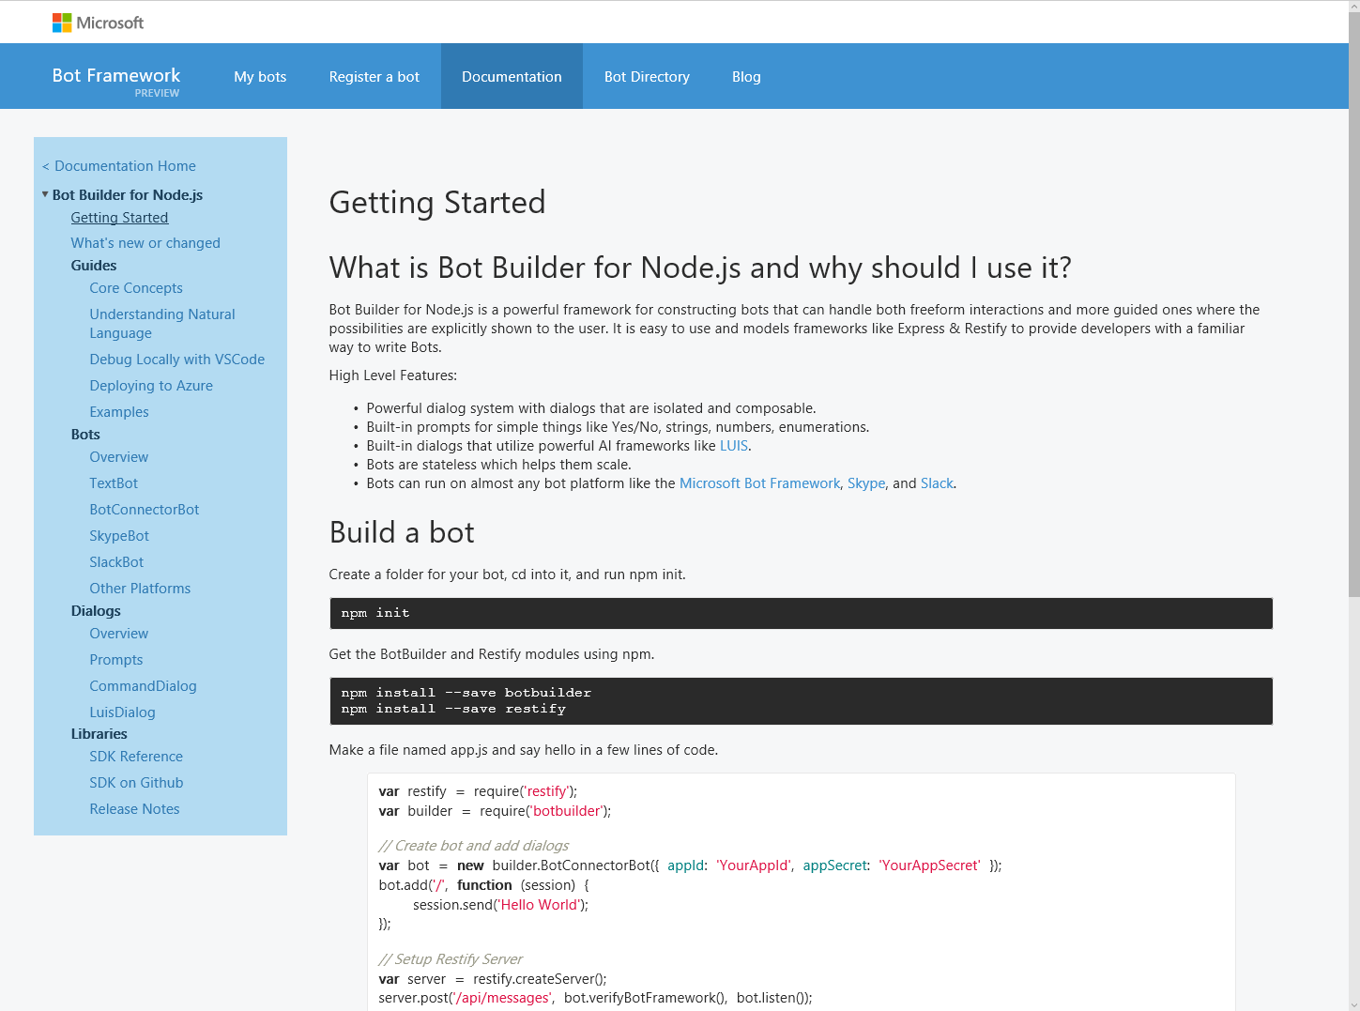
Bot Builder SDK
Node.js, .NET and REST
Dialogs to model conversation
Dialogs are reusable
Types of Dialogs include:
Built-in prompts
Yes/No, String, Number, Choices
FormFlow and form slot filling (branching, disambiguation, multi-turn)
Conversations are scalable to multiple machines
Rich interactions
Support for rich attachments (image, card, video, doc, etc.); support for calling (Skype)
Service extensions for language understanding (LUIS) and translation
Online/offline Chat Emulator
Samples

Slide 11
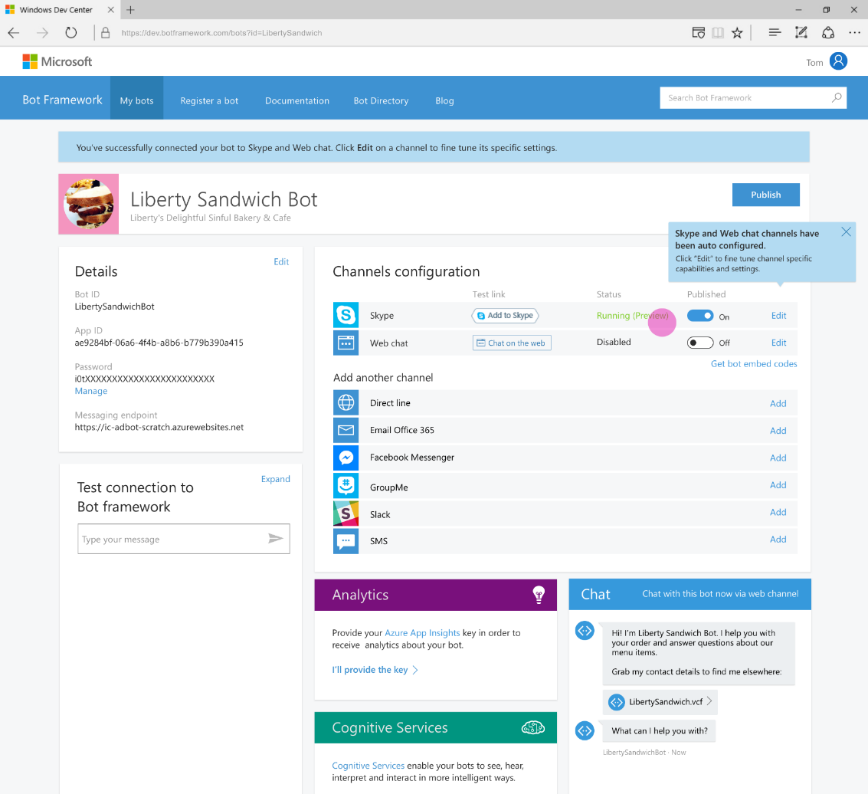
Developer Portal
Register your bot
Connect to channels
Test
Publish
Manage
Measure

Slide 12
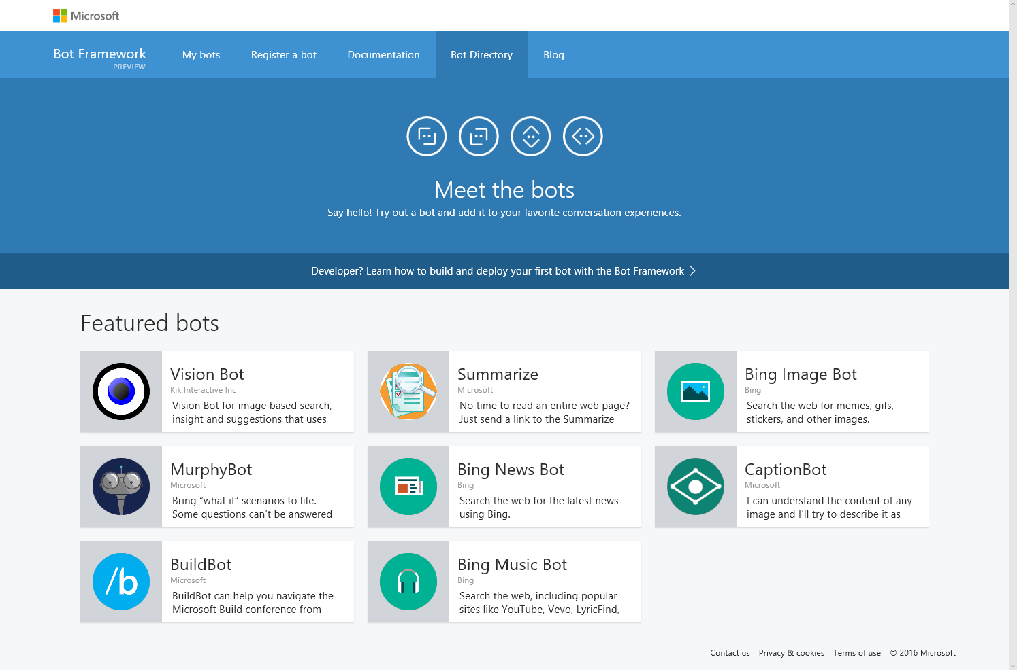
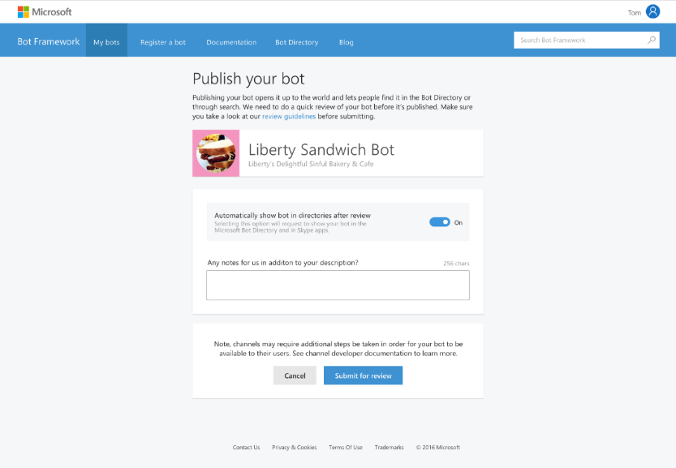
Bot Directory
Public Directory of Bot Framework Bots
Users can discover, try, and add bots to the conversation experiences on which the bot is configured (no app required)
Bots are public at developer discretion; bots must be submitted for review in order to appear in the directory
Searchable

Slide 13
Benefits
For developers
Easiest way to reach the broadest set of users where they already are conversing
Excellent integration with companion services to add intelligence to your bot, such as LUIS for language understanding as well as many other Cognitive Services
For end users
Users can choose from a variety of conversation channels
Users have trust and control of their data
For businesses
Broad access to your customers, new ways to delight them, serve them, do business with them – in your own web site or app or in any number of popular messaging experiences
Reduced cost of development

Slide 14
Demo
Building a simple bot using the Microsoft Bot Framework

Slide 15


Azure Bot Service Preview
Accelerate development cycles
Enrich your bots
Boost operational efficiencies

Slide 16


Azure Bot Service Preview
Accelerate development cycles
</>
Develop your way
Built in code editor
Quick start templates
Integrated chat window

Slide 17









Azure Bot Service Preview
Enrich your bots
API
Channel support
Cognitive Services
Direct Line support
Embedded web chat

Slide 18

Azure Bot Service Preview
Boost operational efficiency
Powered by Azure Functions
Continuous deployment
Scale on demand
Reduced dev ops

Slide 19
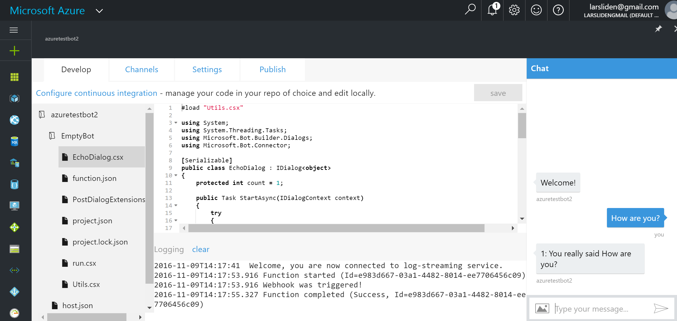

Slide 20
Demo
Getting started with Azure Bot Service

Slide 21
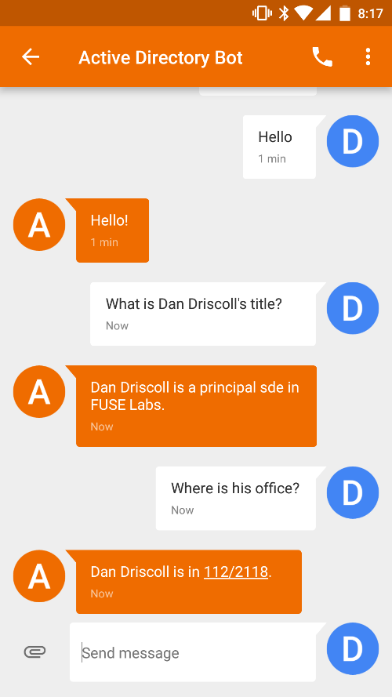
Language Understanding Intelligent Service (LUIS)
John
Sue
Erika
Who is _____?
Where does _____ work?
What is _____’s phone number?
Examples of intent detection
Examples of entity extraction

Slide 22
Demo
Integrating LUIS into your bot

Slide 23
Sign up for a free Azure Trial https://azure.microsoft.com/en-us/free/
Next steps
Create your first bot https://azure.microsoft.com/services/bot-service/
Microsoft Bot Framework https://dev.botframework.com/

